Slide 1


Prototype Submission Phase

Slide 2
TEAM NAME :asvitha.s2022csbs_02fc
Member 1 : Asvitha S Member 2 : Rohith S
Using multiple LLM agents to solve problems in ecommerce, travel, fintech, mobile, media
THEME:

Slide 3
PROBLEM STATEMENT
Our main aim is to bridge the gap between online and offline shopping.
Major difficulties in online shopping are:
There is no individual like a salesperson who can assist in purchasing the right product for a consumer.
To get a good idea of a product, one has to do the tedious job of going through lots of reviews about that product.
For fashion products like clothing, sunglasses, etc., one is not able to judge how it would look on them.

Slide 4
SOLUTION
Shopping Assistant , a chatbot, which can assist consumers in buying the right product.
Summarized reviews will also provide a summary of all the reviews about that product, which will help the consumer to make a wise decision.
Virtual Try On helps the consumer to virtually experience dress or a spectacle.
Frameworks : Caffe ,Openpose, Pytorch, Tensorflow
Tools : OpenCV, NumPy, JSON, TPS, Neural Networks & Convolution Layers, Pillow, OS Module, Groq
Technologies : React js, NLTK, FastAPI, Docker
The reason behind choosing the technology /framework is efficiency,flexibility,specialized framework, robust image processing

Slide 5
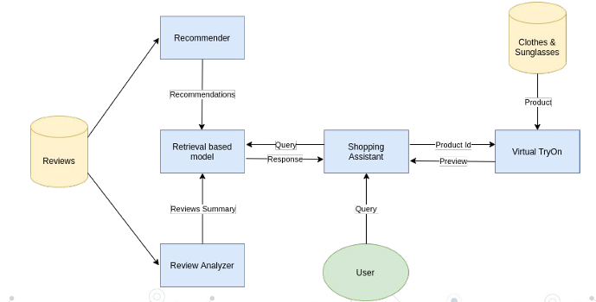
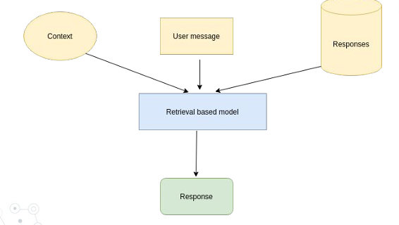
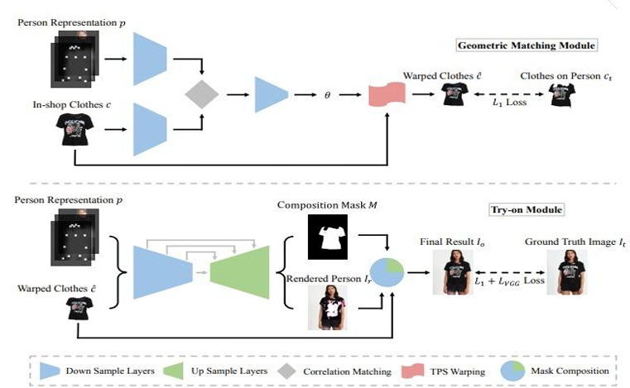
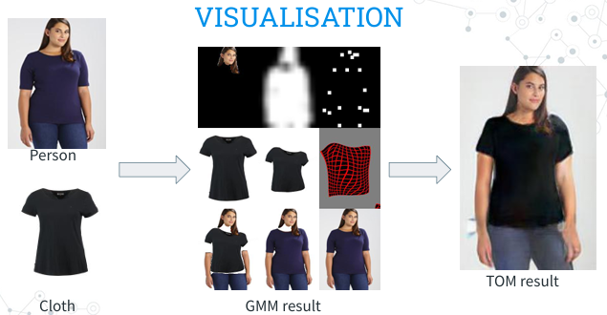
METHODOLOGY
Works on a retrieval-based model
Uses weighted TF-IDF and cosine similarity to quickly retrieve the closest response for a query.
The responses were categorised mainly into 4 types:
1. Product suggestions
2. Summary of reviews of a product
3. Virtual trial of wearables like T-shirts, sunglasses
4. General talk (greetings, thanking)
Workflow
Chatbot
Virtual Try On
Output
Geometric Matching Module (GMM) : It transforms the target cloth to warped cloth so that it can be aligned according to the person’s body shape and pose.
Try-On Module (TOM): It fuses the warped cloth with the target person and synthesizes the final try-on result

Slide 6
IMPACT
Enhanced shopping experience
More Engagement on Platform
Save retailers and customers from the expense of returns and exchanges.
Avoid immense installation cost of trial rooms, showrooms etc.
Time-efficient shopping
More Sales
FUTURE SCOPE
GPUs can be used for further reducing the latency of virtual try-on,implementing live try on for wide range of products
A mobile app can also be developed
The script for storing the summary of reviews of a product can be run at regular intervals using a web worker.
Speech to text and Voice synthesis can be added to the chatbot
Multiple Language Support for the chatbot.
Order Tracking and more Personalised

Slide 7
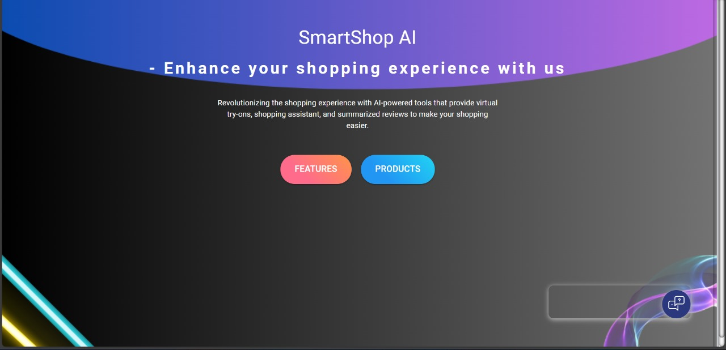
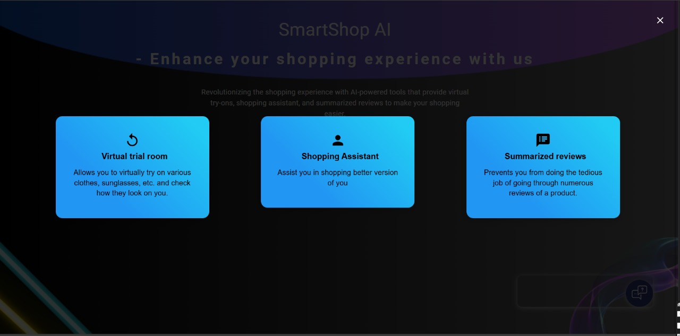
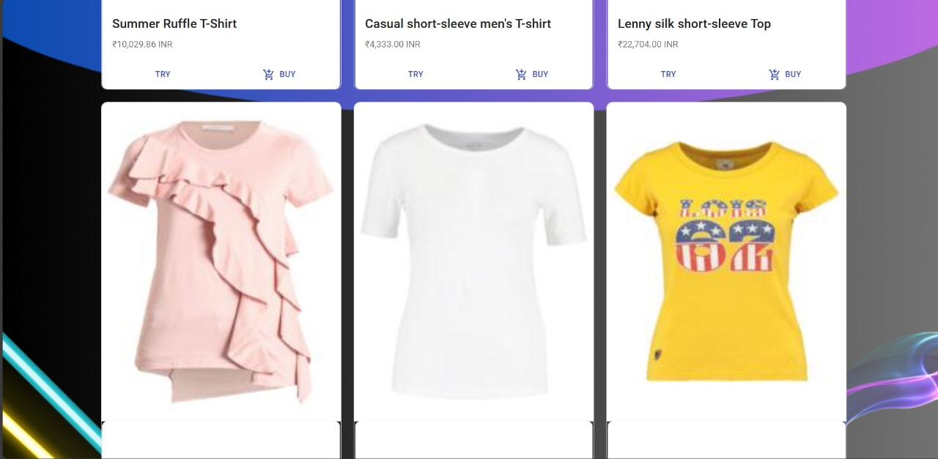
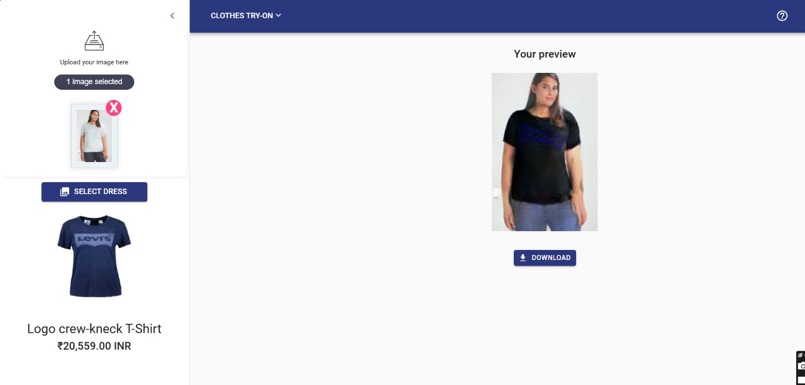
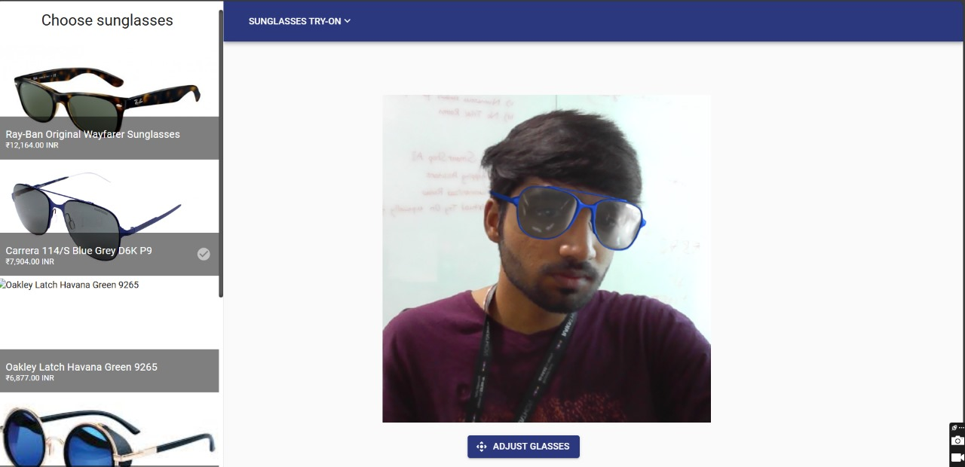
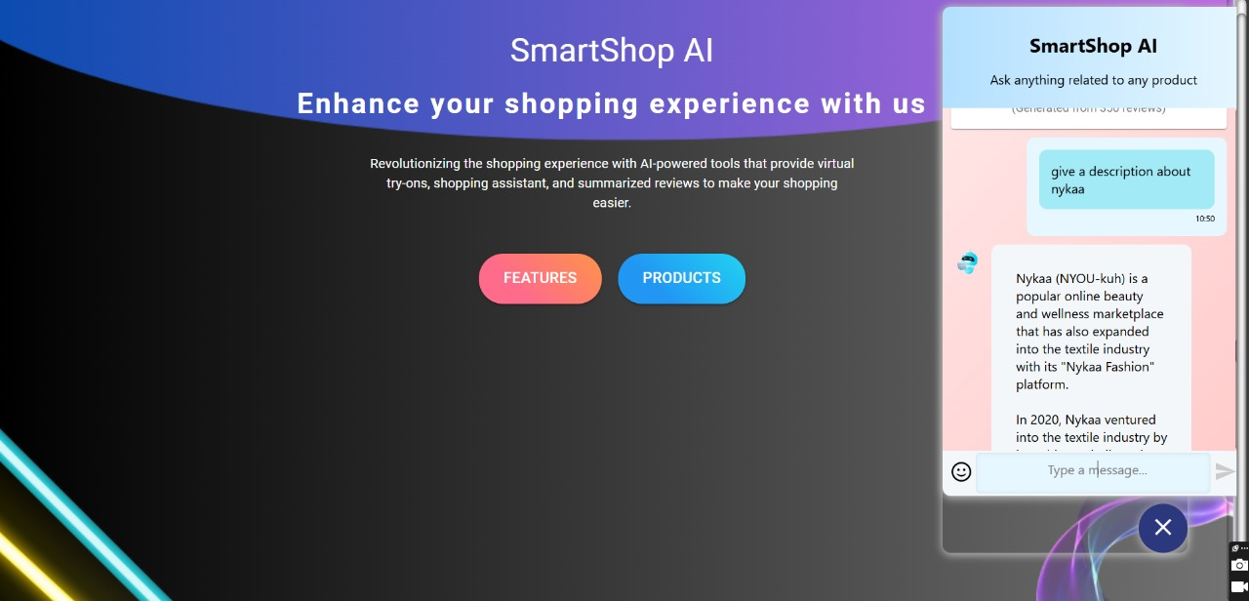
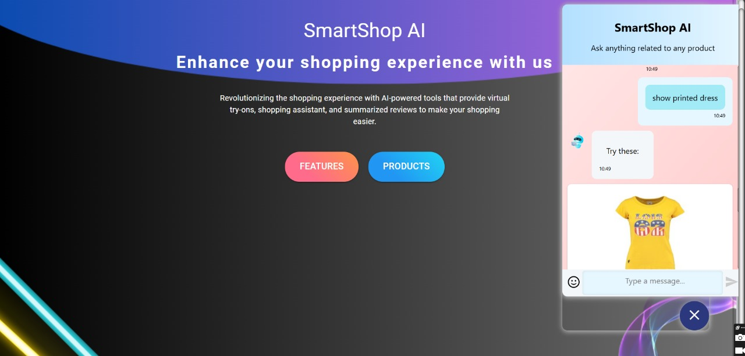
Working Prototype & Attachments
Home
Features
Products
Virtual Trail on clothes
Sunglasses Tryon
Summarized Review
Shopping Assistant
YouTube Link for Demo : https://youtu.be/PnGEnGcdink
Github Link : https://github.com/Rohith16-code/Rakathon---SmartShop-AI/tree/main

